Slide 1
Introduction to Jitter and Phase Noise
Presented by Deepa Kulkarni
Guided by : Neeraj Mishra, BITS Pilani

Slide 2
Presentation Topics
Introduction to the main topics discussed
Motivation for the chapter
Noise & Its types
Device Noise and Propagation
Power and Spectral Density
Jitter & Phase Noise : definition and types
Jitter vs Phase noise
Types of Jitter
Trade-offs in Design
Basic Phase noise mechanisms.
Effect of Jitter & PN on Performance

Slide 3
Motivation – Why is this chapter Important ?
In the Last chapter, we understood that phase noise and power are inversely related. Balancing between the two is very important.
The design of PLL deal with jitter and phase noise.
That’s why this chapter focuses on jitter and phase noise before diving into the detailed design of ring and LC oscillators.

Slide 4
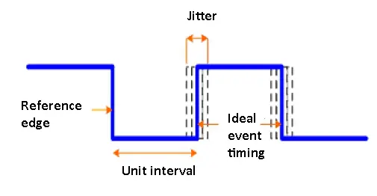
Intro to Jitter and Phase Noise
Jitter happens when the expected zero-crossing of the signal is shifted slightly from where it should be.
  It is a Time-Domain Phenomenon.!
Phase Noise is the random fluctuations in the phase (or zero crossings) of an oscillator o/p
  It is a Frequency-Domain Phenomenon..!
We will dive into detailed comparison later in the presentation

Slide 5
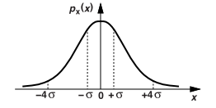
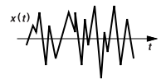
Noise: Concepts & Types
Noise is random:
- Its value at any instant (in time) can’t be predicted.
Examples: traffic sounds, people talking in a restaurant, river flow.
Time Domain View :
- The probability density function (PDF) tells us how often different noise values (or noise amplitudes) can happen.
- if the noise is generated by many sources independently, we expect its PDF to be a Gaussian distribution. (bell-shaped)
- curve is centered at the mean (μ), and its spread is determined by the standard deviation (σ) - Peak value (or amplitude) rarely exceeds ±4σ
Notes:
The PDF tells us how often different noise values are likely to happen.
WHY PDF ???
It is a property of noise that can be computed in time-domain.
For a standard normal distribution: About 99.994% lie within ±4σ.
When modeling noise (like thermal noise or flicker noise), if it's Gaussian:
±4σ bounds act as a practical limit for expected noise amplitude.

Slide 6
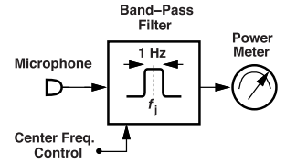
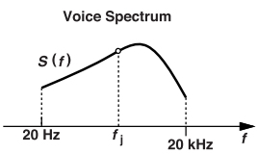
Frequency Domain View:
- Generally, noise is studied in Frequency-domain.
- Since Noise is Random and is spread across the freq-range ,
Fourier Transform of the signal will not result in a clean Frequency chart.
How is this solved ??
- We analyze noise using its power spectral density (spectrum).
- This shows how much power (energy) the noise has at each
frequency.
Example : Voice contains frequencies from 20 Hz to 20 kHz.
  A microphone captures the sound.
  A band-pass filter lets only 1 Hz around a chosen frequency pass.
  A power meter measures the signal's power.
  Sweeping the filter from 20 Hz to 20 kHz gives the voice spectrum, S(f).
Notes:
Why FT gives a messy chart if signal is NOISE. ??
The FT is a math tool used to convert a signal from the time to the frequency domain.
For pure sine wave or a square wave, the FT gives us frequencies that are present in the signal. It also tells us how much amplitude each frequency component has (clear energy chart).
It Create a clear frequency-domain plot showing spikes at specific frequencies.
PSD – power density function
-In practice : For high frequencies it’s hard to make a 1-Hz-wide filter.
-So we use a wider filter, like 1 MHz, and divide the power by 10^6 to estimate how much power would be in just 1 Hz.

Slide 7
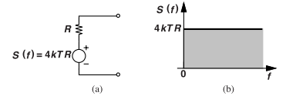

Device Noise
In CMOS, noise mainly comes from resistors (thermal) and MOSFETs : thermal & flicker (1/f).
Resistors
Convert thermal energy into voltage across it.
Spectrum of the voltage is given by : S(f) = 4kTR V²/Hz
The noise is modeled as a voltage source in series with the resistor.
Also called the “white noise” as it carries equal power at all frequencies.
Sometimes modeled as a parallel current source: S(f) = 4 k ( T/R ) A²/Hz
Why you can't write Vn = √(4kTR).
4kTR tells us how much noise power (in volts²) is present in each 1 Hz slice of frequency. It doesn’t give actual power.
Notes:
How does thermal Ek produce noise ?
- Because thermal energy causes electrons to move randomly, creating small voltage fluctuations.
Why is the PSD in V²/Hz instead of W/Hz?
Because it represents voltage noise power, not actual energy power. It's the mean square voltage per Hz.
Voltage noise power refers to the random fluctuations in voltage that occur due to various noise sources within a circuit. Actual energy power is : consumed energy.
3. Smaller resistors produce less thermal noise : 4kTR
4. Ideally, capacitors and inductors do not produce noise, but they help to shape the noise spectrum.
5. Capacitors and inductors store energy, not dissipate it. Since they don’t lose energy as heat, they don’t generate thermal noise on their own.
Note : practical capacitors and inductors have some resistance which may lead to thermal noise

Slide 8
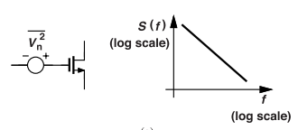
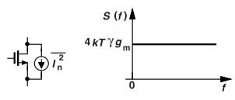
MOSFET :
1. Flicker noise (1/f)
A type of voltage noise that affects MOSFETs at low frequencies
Modeled as Voltage source in series with the gate.
Spectrum of the voltage :
  S(1/f)(f) = K / (W*L*Cox*f) V²/Hz
  K is a process-dependent parameter
2. Thermal noise
The thermal noise of MOSFETs in the saturation region.
Modeled as a Current source parallel with drain and source terminals.
Spectrum of the voltage :
  S(f) = 4kTγgm A²/Hz
  γ : Excess noise coefficient (≈ 2/3 to 1)
  Higher γ = more thermal noise.. Compared to ideal model
Notes:
Why is the Vn connected to the gate ?
Because flicker noise starts near the gate, where tiny defects randomly change the voltage.
What happens to flicker noise in higher frequencies?
It simply decreases.
Why does flicker noise depend on 1/f and device area (W·L *Cox)?
Noise is inversely related to frequency and the device area
Noise is less in devices with bigger areas
Why thermal noise is more pronounced in the saturation region ??
- MOSFETS with Shorter channels and higher electric fields make electrons move faster and more chaotically.
- This extra movement (caused by heat) creates more noise in the current.
FUN FACT : PMOS has less flicker noise because holes are less affected by gate oxide traps than electrons.
So, when flicker noise is a problem ; PMOS is preferred for critical low-noise paths.

Slide 9
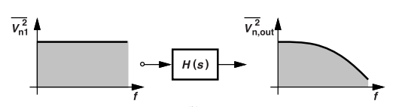
Propagation of Noise
Q. How does Noise generated at the source affect the output ?
Steps to Find out the propagation of noise :
  Find Transfer Function :
    get H(s) from Vn1 to Vn,out.
  Frequency Domain :
    put s=jw ; get H(f) ; Magnitude |H(f)|^2.
  Get Output Noise Spectrum :
    Sn,out(f)=Sn1(f) * |H(f)|^2
Sn1(f) denotes the spectrum of Vn1
|H(f)|^2 shaped the noise signal
Example : If Sn1(f) is white and H(s) a low-pass filter.
Sn,out(f)
Notes:
1. Why do we use |H(f)|² instead of just |H(f)|?
Because noise power (V²) depends on the square of the voltage gain, not just the gain itself.
2. If noise is random, how can we predict its effect at the output?
We can't predict each noise value, but we can predict its average power across frequencies using power spectral density and the circuit’s transfer function.

Slide 10


Power & Spectral Density
Average Power of Noise
For a random signal, x2(t), we define the average power as :
  Integrate its squared value over the time.
  T denotes the period
The average power can also be obtained from the spectrum of the signal.
  Integrate its value over the freq range.
Parseval's theorem : Total average power = Area under the Spectral Density Curve.
If a frequency has power in the spectrum, it shows up as part of the random waveform in time.
Notes:
Every Frequency component contributes to its time-domain fluctuations.
HOW ???????
Noise in time domain = random fluctuations.
Those fluctuations come from many frequency components.
Each frequency band (from low to high) contributes a part of the total noise power.
And Parseval’s theorem guarantees that the total contribution (energy or power) adds up equally in both domains.
If you remove some frequency components (like in filtering),
- You’ll see less noise fluctuation in time.
- Because those frequencies no longer contribute energy to the signal.

Slide 11
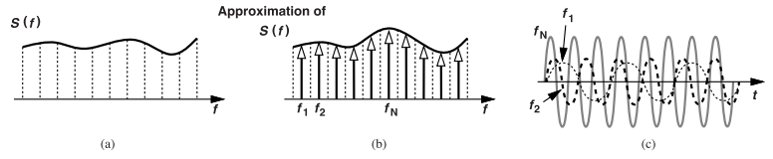
Approximation of Noise Spectrum
Noise with any spectrum can be approximated by breaking it into many narrow frequency bands(called silvers /slices) .
Each band is represented as an impulse, which corresponds to a sinusoid in the time domain.
So, the noise is modeled as the sum of many sinusoids at different frequencies.
But this is only for short period of times that match the bandwidth of each frequency slice.
EXAMPLE: If each slice is 1 kHz wide (in freq domain), the sinusoid model is only accurate for about 1 millisecond
Beyond that, the sum of sinusoids can't fully capture the randomness.
To model noise accurately over longer times, we use narrower slices.
Notes:
t= 1/f = 1/1Khz = 1ms.
What happens if we use too few frequency slices to model noise?
= The model won’t capture the random nature of noise over longer timescales.
And if we increase the no. Of slices, we get a more accurate noise model.

Slide 12
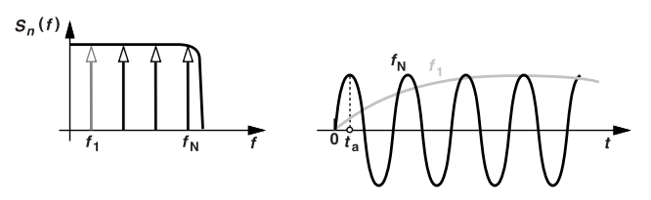
Accumulation of Noise with Time
When looking at noise over a short "observation window” of [0 to ta] ,
  Only the fast-changing (high-frequency : fN) noise components matter.
  Slow noise (low-frequency: f1 ) doesn’t change much during that window, so it affects the signal less.
  Observing noise for tₐ seconds is like applying a high-pass filter that blocks very slow noise variations and lets through only high-freq noise.

Slide 13
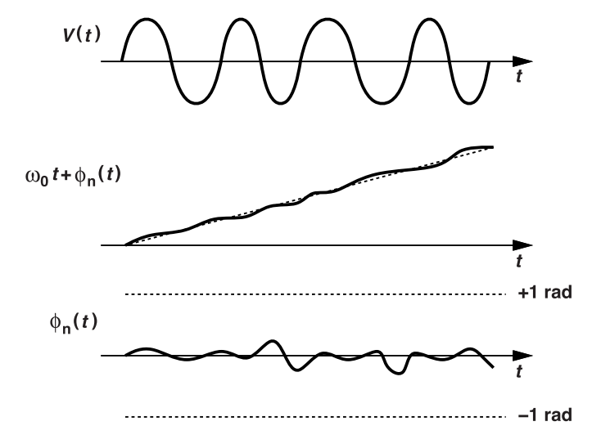
Basic Jitter and Phase Noise Intro
A perfect oscillator has fixed timing, but real ones have noise that causes random shifts in phase called jitter and phase noise.
We model this as: Vout (t)=V0 * cos(ω0* t + ϕn(t))
  where ϕn(t) is the excess phase (noise induced)
  ω0 is called as the "carrier" frequency. (ideal)
EXAMPLE:
Plot Vout (t)=V0 * cos(ω0* t + ϕn(t)) if ϕn(t)<<1rad.
  Total phase is the entire argument inside the cos()
  Excess phase is the phase in addition to the w*t term.
  Since phi_n(t) is way lesser than 1, it causes mild disturbances in the straight-line waveform of w*t
Notes:
ω0 is called as the "carrier" frequency. (ideal) WHY ?
The actual output wobbles around ω0 due to noise, but ω0 is still the central reference.
It carries the actual output signal.

Slide 14
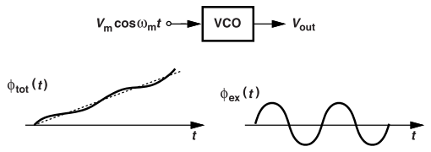

Jitter : Definition
As discussed before Jitter is deviation of zero-crossings of a periodic signal from its ideal points. And it is a Time-domain phenomenon.
Example : Can VCO's exhibit Jitter ??
  Input : Vcont (t) = Vmcos(wm*t)
  Output Vout(t)
  Observation : The maximum departure of the zero crossings from their ideal points in time occurs when the excess phase reaches a maximum or minimum.
Deterministic jitter : Arises if the osc freq (w) is periodically disturbed.
Peak to Peak Jitter = (2*Kvco*Vm)/wm radians = (2*Kvco*Vm)/(wm*w0) sec
{Note : if we increase wm ; we reduce the Jitter}
Notes:
Why does the excess phase oscillate?
- {Kvco/wm} sin (wmt) is the excess phase : it oscillates as Sine wave
- with an amplitude {Kvco/wm}
2. What does the observation mean ?
- The max and the min amplitude / deviation of the Phi_total (t) from the ideal w*t line is due to the period motion of the excess phase.

Slide 15
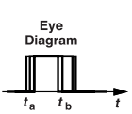
Visualizing and Measuring Jitter: The Eye Diagram
Take multiple cycles of the “jittery” clock signal and stack them on top of each other.
This is done by using an ideal clock as a reference and overlaying each measured cycle.
The wider the eye opening, the less jitter; a smaller opening means more jitter.
An eye diagram is a powerful way to see timing jitter, but frequency analysis is needed to know if the noise is random/deterministic.
Jitter types : Random and Periodic fluctuations in the signal
Notes:
Eye diagram is a diagram which shows the deviation of Clock cycles from their ideal cycles all in one picture.

Slide 16
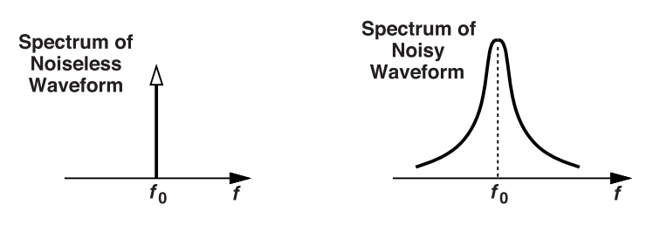
Phase Noise: Definition & Spectra
Phase noise : Random fluctuations in the phase of an osc output.
It is analysed in freq domain only.
Vout (t)=V0 * cos(ω0* t + ϕn(t)) where ϕn(t) is called as Phase noise.
Effect on Spectrum
Ideal case : The spectrum is just a single spike (impulse) at the carrier frequency (f₀).
Phase noise spreads the energy, so the spectrum is no longer just at f₀, but is “broadened” around it. {Why ? frequency randomly jumps around f₀ due to noise}

Slide 17
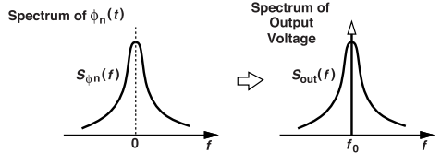
Relationship b/w Phase Noise Spectrum and Output Spectrum
Vout(t) = V0 cos[ω0t + φn(t)] ≈ V0 cos ω0t − V0φn(t)sinω0t.
Assume φn(t) <<1 rad
Carrier ω0 is responsible for the shift of ϕn(t) spectrum from 0 to f0 in the output voltage spectrum.
Farther you go from f0, less likely you are to see large deviations.
  Spectrum Tappers off.
How do we measure Phase noise ?
Pick a frequency offset ; (100kHz away from f0).
2. Measure the noise power in a very narrow range (1 Hz wide) at that offset.
3. Compare this noise power to the main signal’s power (the carrier power).
4. Express the result in dBc/Hz (decibels relative to the carrier, per Hertz of bandwidth).
Notes:
Measuring Phase noise:
Phase noise isn’t the same at all frequencies—it changes as you move away from the main signal frequency (f₀). To measure and compare phase noise, we use a standard method:
- When we select the offset; we measure noise power using power spectrum density at that freq.
- By Comparing we mean Normalising the noise power.
2. What do you mean by normalising the noise power?
the normalized output noise spectrum is just the phase noise spectrum centered at f0 instead of 0.

Slide 18


Jitter vs. Phase Noise
For deterministic Jitter , we use peak-to-peak jitter i.e., (2*Kvco*Vm)/wm radians.
  This is 4 times the normalized Sideband Magnitude (as discussed before).
For random jitter, we use RMS value
  Peak-to-peak jitter only makes sense for repetitive, bounded patterns, but random jitter can, in theory, be infinitely large.
  RMS jitter gives a statistical measure of the average size of timing variations, making it practical for real systems.
Calculate RMS Jitter:
  RMS Jitter = the square root of the area under the phase noise spectrum.
Parseval’s theorem that the average power is equal to the area under the spectrum:
Notes:
WHY RMS??
For accurate comparision of Jitter vs Phase noise;
We have to use random Jitter as phase noise is also strictly due to randomness of the noise.
While Comparing random jitter and phase noise, we use RMS jitter instead of the Peak-to-peak Jitter value as reason mentioned above.
HOW TO CALCULATE RMS??
Jitter is a time-domain deviation from ideal points.
It is considered as a random signal.
Random jitter can have positive or negative shifts.
Squaring removes the sign.
Averaging gives the mean squared deviation.
Taking the square root brings it back to units of time (like ps or ns).

Slide 19
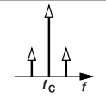

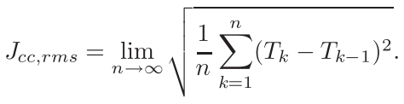
Types of Jitter : In detail
Deterministic Jitter :
  Caused by predictable, periodic effects. (Due to Periodic Modulation)
  Seen as sidebands in the frequency spectrum.
  Bounded ( has peak-to-peak value )
Absolute Jitter :
  Caused by low-frequency noise
  No external reference, so error accumulates over time.
  Grows without limit — unbounded.
Cycle-to-Cycle Jitter :
  Measures the period changes from one cycle to the next : Jcc=Tk−Tk−1.
  Bound and Measurable
  For many Cycles , rms value of Jcc :
Notes:
Stand-alone Osc : a free-running circuit that generates a periodic signal without any external reference.
When is jitter considered bounded?
Jitter is bounded when it does not grow indefinitely over time and stays within a predictable range.
Cycle-to-cycle Jitter: causes by High-freq components

Slide 20
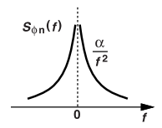




Only high-frequency noise affects this, so it remains small and bounded.
Example : White noise Induced Phase noise Sφn(f) :
Assume Sφn(f) = alpha/f^2 ; Power declines as |f| increases.
If this phase noise affect a 1GHz o/p of Oscillator, only the higher frequency components will affect the output.
So, the white noise induced phase noise is (w0 is osc freq) :
We simplify the equation to and finally to this :
4. Period Jitter (also called Cycle jitter):
  Random departures of the period from its the average value, Tavg.
  Jc = Jcc/ √ 2 for white-noise-induced jitter. Here,
  Bounded
Notes:
High-pass filtering effect : Observing Jitter for a cycle ; Low-freq noise don’t change over this time period; Only high-freq noise allowed.
Period jitter is also caused by High-freq noise

Slide 21
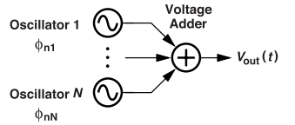
Trade-Offs b/w Phase noise and Power
Power and phase noise are Inversely related.
EXAMPLE: Add N-identical oscillators to an Adder.
Output of 1-osc: Vout(t) = V0 cos ω1t − V0φn1 sinω1t
Output of N-osc : Vout (t) = N*(V0 cos ω1t) − V0(φn1 + · · · + φnN )sin ω1t.
The normalized phase noise is equal to (φn1 + · · · + φnN )/N and exhibits a spectrum given by : Sφ(f) = Sφn1 + · · · + SφN / N^2
N-osc phase noise spectra are equal and uncorrelated; Sφ(f)=Sφn1/ N
  Phase noise is reduced by N times But power increases by N^2 times
This method doesn't apply for deterministic jitter.
Notes:
Why doesnt apply for deterministic jitter?
Because deterministic jitter is not random — it's correlated across all oscillators.

Slide 22
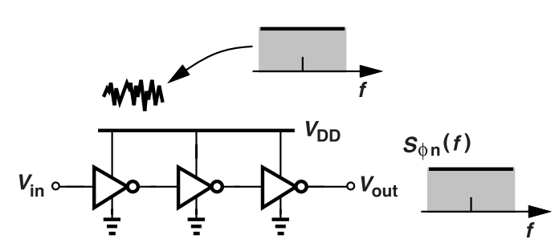
Basic Phase Noise Mechanisms
Phase noise vs frequency noise
  a) Delay Line (chain of inverters) :
    Delay of the chain of inverters depends on the supply voltage Vdd.
    ΔV change in VDD creates ΔtD in the line’s delay and Δφ phase shift.
    Supply noise is Vn, the output of the delay line is expressed as :
      Vout = {VDD/2} + {VDD/2} * cos(ωint + φ0 + KDD*Vn)
      Phase shift due to Supply noise is : (KDD* Vn)
  Since, phase shift Kdd*Vn is linear, white supply noise directly changes the output phase resulting in the white phase noise
Notes:
What is supply sensitivity (KDD)?
- It’s how much the phase shift changes for a given change in supply voltage.

Slide 23

b) Ring Oscillators:
  VDD in ring Oscillators affect both frequency and phase.
  Higher VDD = Higher Oscillation frequency.
  white supply noise translates to white frequency noise
  Gain from Vdd is KDD = ∂ωout/∂VDD ;
  The oscillator output is :
If length of delay line made infinite ; will its phase noise match that of a ring oscillator. ???
  In a delay line, the phase noise is added linearly since supply noise directly affects phase noise.
  In ring oscillators, noise changes the oscillation frequency, which then accumulates over time into phase noise.
  The assumption misses the integration effect in oscillators.
Notes:
Note : VDD supply noise in delay lines causes momentary phase shifts,
but in ring oscillators, it causes frequency drift, which accumulates into much larger phase noise over time.
There's no osc freq in delay lines as they don’t oscillate
Ring osc face freq shifts => greater phase shifts in time

Slide 24
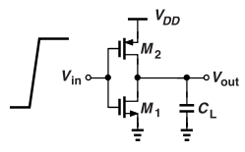
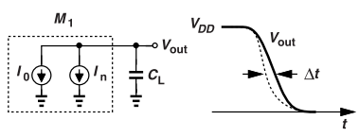
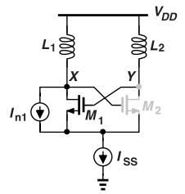
2. Ring oscillators : Jitter & Phase noise
  Input rises from 0 to VDD.
  M1 : turns on and discharges through CL. {Vdd to 0}
  In : Noise from M1: flows through CL Causing Jitter Δt.
  White current noise = white phase noise for Inverter.
For N-cascaded Inverters:
  Phase noise rises by N factor
  RMS jitter by root(N) factor
3. LC Oscillators : Jitter & Phase noise
  In1 (thermal noise from M1)
  injects jitter into the LC tank, but only when M1 is ON.
  When M2 is OFF, ISS blocks In1
  So, noise reaches the tank only during part of the cycle.
  Thus, its effect on phase is time-dependent.
Notes:
For N-cascaded inverters :
In a ring oscillator with N stages (inverters), each stage adds its own noise.
Since phase noise adds linearly, the total phase noise increases in proportion to N.
RMS jitter from independent noise sources adds like random variables, not linearly.
like adding N uncorrelated noise signals : power adds, but amplitude (RMS) adds as √N.

Slide 25
Effect of Jitter & PN on Performance
Jitter
Affects data sampling, especially in high-speed links (e.g., processor to memory).
Ideal clock samples correctly; jittered clock may cause logic errors or metastability.
Safe limit: Clock jitter must be less than half the data period.
Phase noise
Interferes with Nearby Channels : Noise spreads out → affects weaker signals on adjacent frequencies.
Corrupts Modulated Signal : Adds random phase error → causes symbol decoding issues (e.g., in WiFi).
Reciprocal Mixing in RX: Strong nearby signals leak into desired signal due to phase noise.

